Slide 1
Sprint 2 Demo
RF Team 1 - Direction of Arrival Project
Cassandra Harrison, Robert Kramer, Sofia Mvokany, Krishna Patel & Kyle Reagan

Slide 2
Introduction
Goal: Create a system that is able to give the geographical position, angle and spectrum characteristics of a drone flying illegally in 915 MHz frequency range.
Achievable using a wide range rotating loop antenna connected to an SDR that will keep track of drone data spectrum at any given time. The position where the data exchange spectrum is the weakest refers to where the drone is located.

Slide 3
Introduction
Split into smaller teams to handle specific parts of the product
Parts include
Telemetry Radios
Software Defined Radios
Rotating Platform
Loop Antenna

Slide 4
Sprint 1 - what was done
At the end of Sprint 1, we had:
Ordered the different pieces of our system
Assigned each member of the team to a focus group for each part of the system
Downloaded software Airspy for spectrum analysis

Slide 5
Telemetry Radios
Radios are Holybro Telemetry radios, 500 mW. Active at 915 MHz.
Once connected, they transmit and receive data stored in the Pix Hawk to each other.
This data transfer can be seen using a loop antenna and a RTL-SDR radio

Slide 6
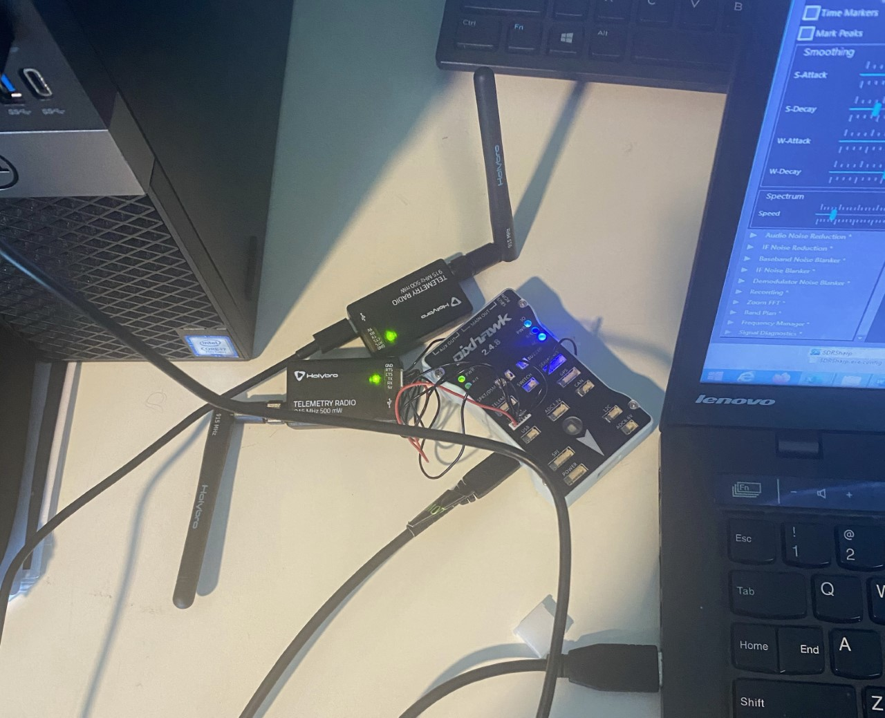
Current Pixhawk and Radio Configuration
The indicator lights show connectivity
When the light starts flashing red, data is being transferred.
Ready to proceed with next sprint focusing on integrating entire system

Slide 7
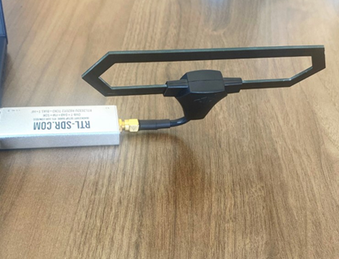
RTL - SDR
The Software defined radio: RTL2832U dongle.
Currently used with a Team Blacksheep Diamond antenna.
Airspy is the software currently being used to display spectrum

Slide 8
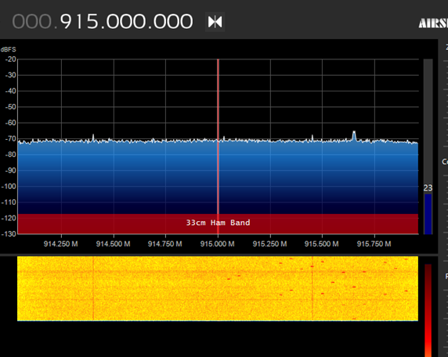
915 MHz spectrum with no data transfer

Slide 9
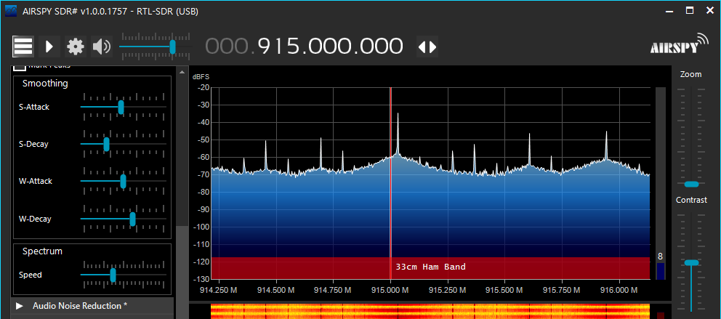

915 MHz spectrum with data transfer

Slide 10
Rotating Platform
Direction
Coded the motor to be able to move clockwise and counterclockwise
Can rotate 360°, 180° or any angle specified in the code
Speed
User can control speed, exact speed wanted can be coded in.
Currently step delay is at 1000 microseconds

Slide 11
Rotating Platform Cont.
Angle
Coded to output the angle at either every degree or every 10 degrees
It’s continuously updating and resets once it’s made a full revolution
0 degrees is the motors initial position

Slide 12
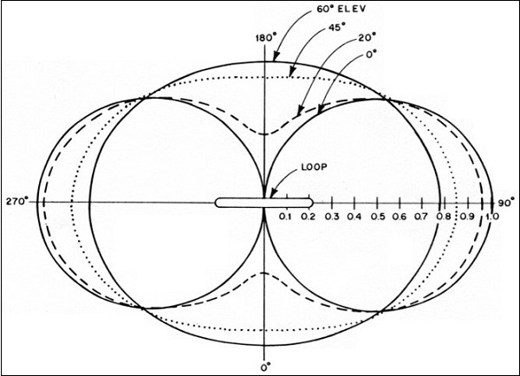
Loop Antenna
Direction
“Deep null” in radiation pattern results in very low signal received when plane of loop is pointing at the signal source
Size
Electrically small (length < λ/10) results in a magnetic loop antenna
At 915 MHz, that would be about 33 mm

Slide 13
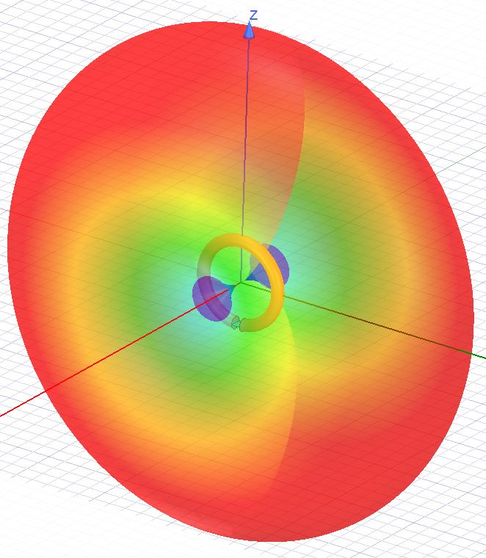
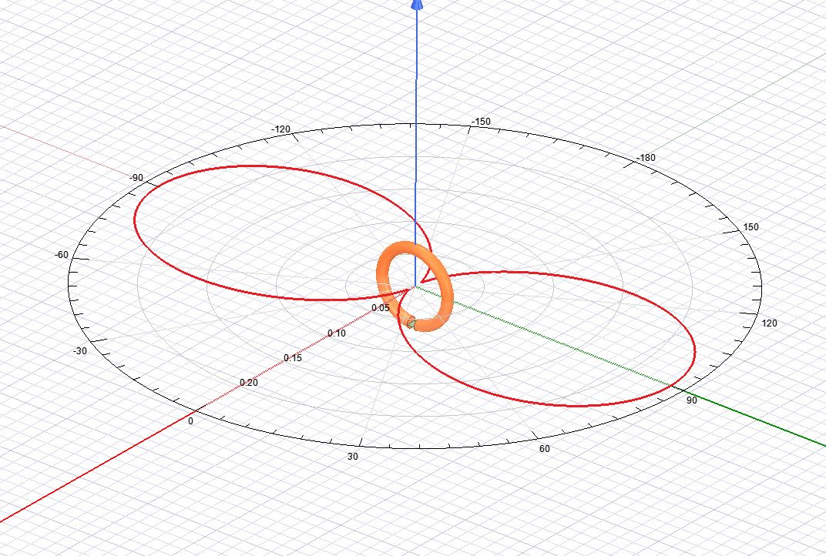
Simulations

Slide 14
Sprint 3 - what are the goals
Acquire a GPS and Mission Planner to gather location data for our system
Build the antenna based on the results of simulations
Brainstorm and execute mounting the antenna on the rotating platform
Test the full system and show that it outputs position, angle at which the antenna receives data and the spectrum of the data exchanged.

